Slide 1
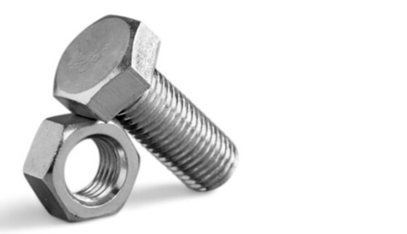
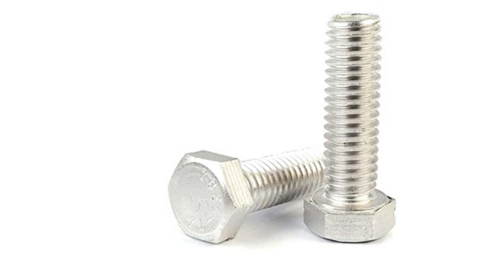
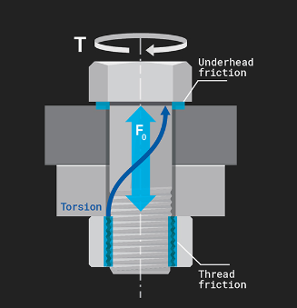
VECV- Bolt coefficient of Friction Library
Bolt diameter
Grade
Thread Pitch
Head type
Coating
Under Head friction
Thread Friction
Aluminum
Cast Iron
Sheet metal

